Slide 1
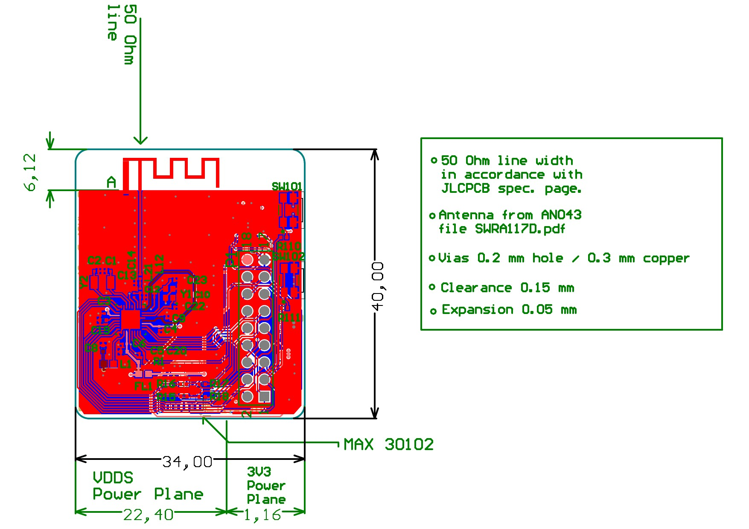
SMARTBAND V001
PCB Component & BOM Analysis
Band01_Rev1 — Hardware Procurement Documentation
Prepared by: Masrur Institution: Hochschule Hamm-Lippstadt (HSHL) Supervisor: Giovanni (giovannix) Task: Task 0 — PCB Review & Procurement
HSHL Internship Project | Band01_Rev1 | March 2026

Slide 2
PROJECT OVERVIEW
Objective
Platform
Research Context
Review the Band01_Rev1 PCB design, validate all components, update the BOM, communicate with providers, and place the manufacturing order.
CC2640R2F BLE SoC
(ARM Cortex-M3, 48 MHz)
Bluetooth 5.0
Wrist-worn form factor
34 mm × 40 mm PCB
Based on the MWHD framework by Pinheiro et al. (2022) — Frontiers in Human Neuroscience. Multi-sensor health data via BLE.
Smartband V001 | HSHL Internship

Slide 3
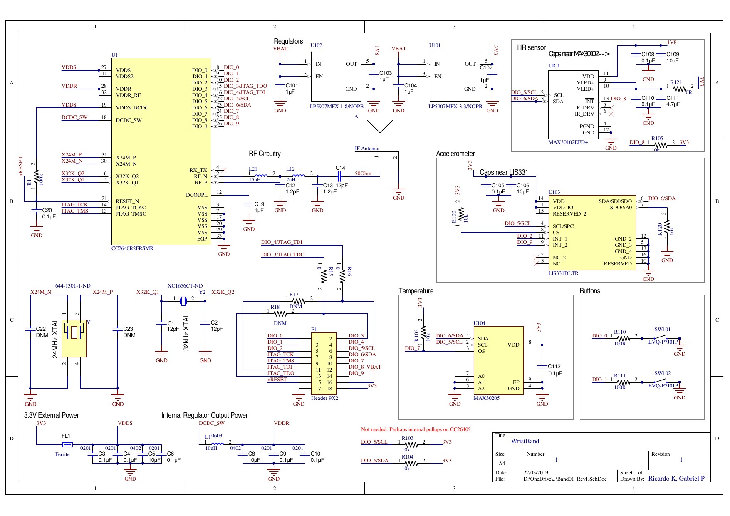
PCB SCHEMATIC — Band01_Rev1
U1 — CC2640R2F
BLE 5.0 SoC / MCU
UIC1 — MAX30102
HR & SpO2 Sensor
U103 — LIS331D
3-axis Accelerometer
U104 — MAX30205
Temperature Sensor
U101/U102 — LP5907
3.3V & 1.8V LDO Regs
Y1/Y2 — Crystals
24 MHz & 32.768 kHz
Designed in Altium Designer | 22/03/2019 | Authors: Ricardo K, Gabriel P

Slide 4
PCB LAYOUT & PHYSICAL SPECIFICATIONS
Dimensions
34 × 40 mm
Layers
2-layer PCB
Via Hole
0.2 mm / 0.3 mm Cu
Clearance
0.15 mm
Expansion
0.05 mm
RF Impedance
50 Ω
VDDS Plane
22.40 mm
3V3 Plane
1.16 mm
Antenna
PCB trace (AN043)
Smartband V001 | HSHL Internship

Slide 5
KEY SENSOR SUBSYSTEMS
MAX30102EFD+
UIC1
LIS331DLTR
U103
Heart Rate & SpO2
Accelerometer
18-bit ADC, integrated LED driver
Optical reflectance sensor
I2C interface
3-axis MEMS, ±24g range
Motion & activity detection
I2C interface
MAX30205MTA+T
U104
CC2640R2FRSMR
U1
Temperature
BLE SoC / MCU
±0.1°C accuracy
Digital body temp sensor
I2C interface
ARM Cortex-M3 @ 48 MHz
Bluetooth 5.0, 128KB Flash
JTAG / SWD debug
All sensors communicate via I2C bus (DIO_5/SCL, DIO_6/SDA)

Slide 6
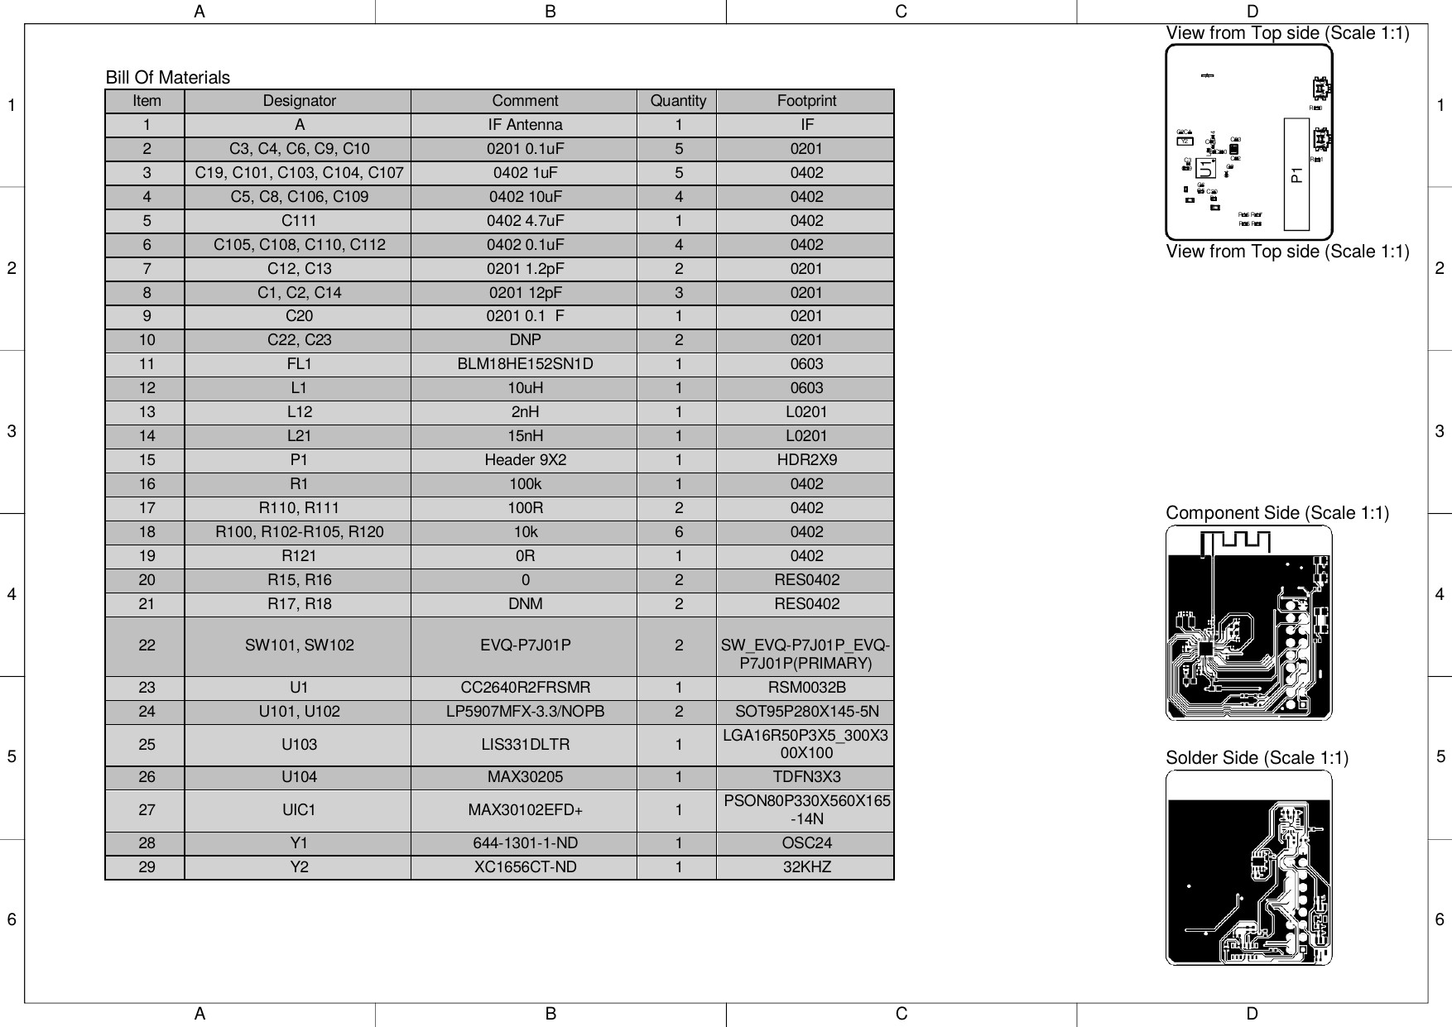
BOM REVIEW & COMPONENT ANALYSIS
33
5
Total Components
Items Needing Action
4
29
DNP / DNM Items
Line Items in BOM
Components Requiring Action:
IF Antenna (A)
PCB trace antenna used — marked DNP
P1 Header
Upgraded to Samtec HTSW-109-07-G-D
C22, C23
DNP optional bypass caps — retained
R17, R18
DNM — JTAG pull resistors not needed
Original BOM.pdf
Y1 Crystal
Sourced muRata equiv. for availability
Smartband V001 | HSHL Internship

Slide 7
PCBWay ASSEMBLY QUOTATION
Product No.: T-2Y3W994845A | 3 Assembled Sets
Component Cost
Assembly Cost
PCB Fabrication
TOTAL (3 sets)
$116.33
$88.00
$25.97
$230.30
Order Details
Unit Cost / Board:
≈ $76.77
Lead Time:
26–28 working days
Quantity Ordered:
3 assembled sets
DNP Items:
A, C22/C23, R17/R18
Assembly Type:
SMT + Through-hole
Platform:
PCBWay.com
Smartband V001 | HSHL Internship

Slide 8
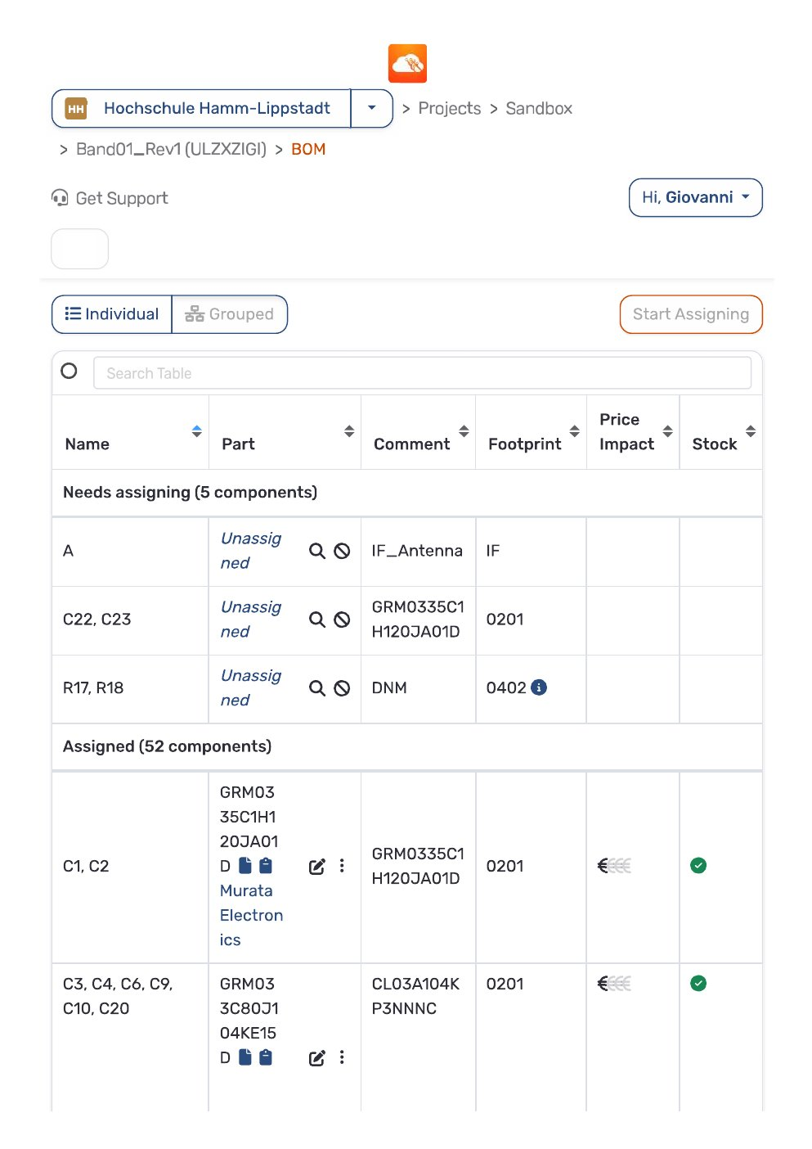
AISLER PLATFORM — FINAL ASSEMBLED PCB
Pricing Tiers (Aisler — Amazing Assembly):
Qty
Total Price
Unit Price
3
€376.69
€125.56
5
€439.65
€87.93
10
€590.66
€59.07
50
€1,893.43
€37.87
100
€3,249.84
€32.50
200
€6,183.19
€30.92
500
€14,134.49
€28.27
✓ 52 of 57 components assigned in Aisler (HSHL workspace)
✓ Prices include sourcing, handling, and assembly fees
✓ Offers valid for 24 hours from quotation
Aisler BOM — HSHL Workspace
Smartband V001 | HSHL Internship

Slide 9
PROCUREMENT PROCESS
1
Received design ZIP from supervisor (GitHub repo)
6
Prepared updated BOM — submitted to PCBWay for quotation
2
Reviewed schematic — extracted all 33 components
7
Received PCBWay quote: $230.30 / 3 sets, 26–28 day lead time
3
Cross-referenced BOM vs. schematic — identified 5 issues
8
Registered project on Aisler (HSHL workspace)
4
Researched availability on Mouser, DigiKey, LCSC, Aisler
9
Assigned all available components in Aisler (52/57)
5
Resolved component substitutions & part number updates
10
Order confirmed — PCB fabrication & assembly placed
Smartband V001 | HSHL Internship

Slide 10
CONCLUSION & NEXT STEPS
Task 0 — Deliverables Completed:
Upcoming Steps:
✓
Complete PCB schematic review (33 components)
→ Await PCB delivery (26–28 day lead time)
✓
BOM validation & 5-item correction
→ Inspect & test assembled boards on receipt
✓
Provider communications (PCBWay + Aisler)
→ Set up Code Composer Studio (CCS) for CC2640R2F
✓
Updated BOM submitted & quotation received
→ Flash firmware — validate BLE communication
✓
Manufacturing order confirmed — 3 sets
→ Begin sensor integration & data acquisition
→ Task 2: Firmware analysis & development
HSHL Internship | Masrur | Ref: Pinheiro et al. (2022), Frontiers in Human Neuroscience

